Slide 1
PBN IN A PAGE
Huho Ha
ATM Officer (AOM-PBN)
APAC Regional Sub-office , ICAO
ICAO Regional PBN Seminar:
Expanding PBN and Facing the Challenges in the Asia and Pacific Regions
08 – 10 June 2015

Slide 2
Background
To discuss PBN implementation,
Participants need to understand the contents of the related materials, such as PBN Manual (Doc 9613), PANS-OPS (Doc 8168), PANS-ATM (Doc 4444), PBN OPS Approval Manual (Doc 9997), etc.
Participants may have different expertise, e.g. ATM, CNS, Procedure Design, aircraft operations, etc.
Due to these factors, time would be required to reach common understanding among participants on NavSpecs and separation standards
To facilitate the discussion,
All PBN related elements was summarized in one page
Participants can join the discussion without flipping through relevant documents to find the criteria
It can help participants come to an agreement easily.

Slide 3
Inputs from users
BIMT Design Session (3-5 Feb. 2015, Beijing China),
RSO introduced the PBN-in-a-page table to the participants
The table was used as a quick reference during the discussion on designing new/amend PBN routes in the northern Bay of Bengal area
It proved as a useful tool when deciding NavSpecs and separation standards and showed the possibility for its use
PBNICG/1 (10-12 Mar. 2015, Beijing China)
The PBN-in-a-page table was introduced to the PBNICG/1
The meeting provided some inputs such as additional functionalities for each NavSpec, the table enhancement, etc.
The enhanced version of the table will be presented to the PBNICG/2

Slide 4
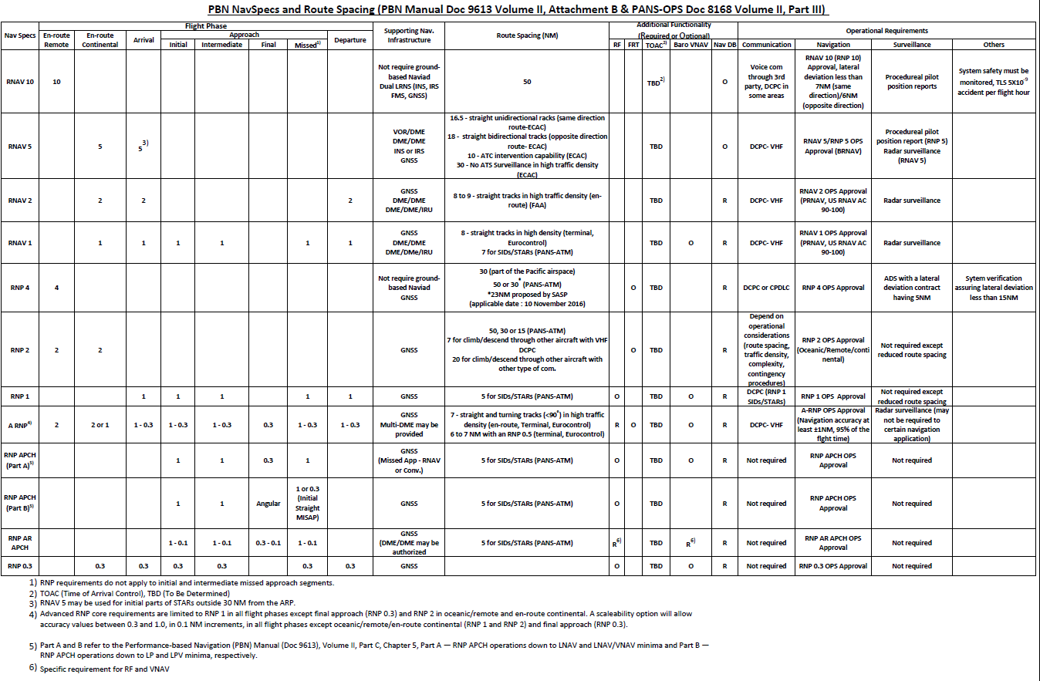
PBN-in-a-page

Slide 5
PBN-in-a-page

Slide 6
PBN-in-a-page

Slide 7
PBN-in-a-page

Slide 8
PBN-in-a-page

Slide 9
Further enhancement and use
APAC RSO will
continue updating the PBN-in-a-page table in line with the amendments of the reference materials and inputs from users
use the table when supporting a State or a group of States during PBN airspace and route design session
use as a quick reference material during PBNICG meeting
States and users are invited to provide inputs on the table for further enhancement

